Slide 1

W221
Empty key Spaces
&
match new keys
CG-MB

Slide 2
When we want to match a new key for the vehicle, find that the positions for key are full. At this time, we need to clear the positions，then match the new key.

Slide 3
The first step
Calculate the password and erase the key位

Slide 4
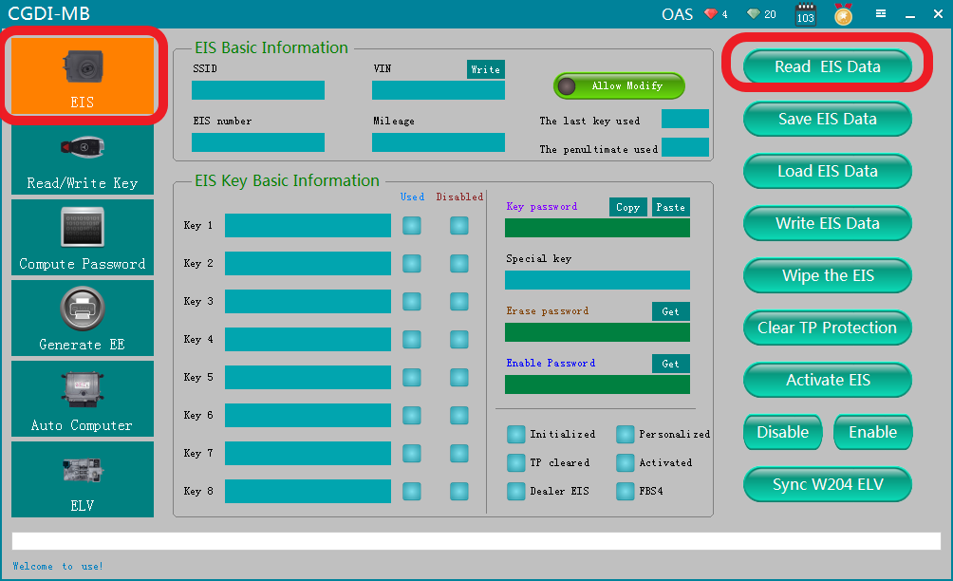
OBD connects the vehicle，choose“（EIS）”interface，click to read EIS data

Slide 5
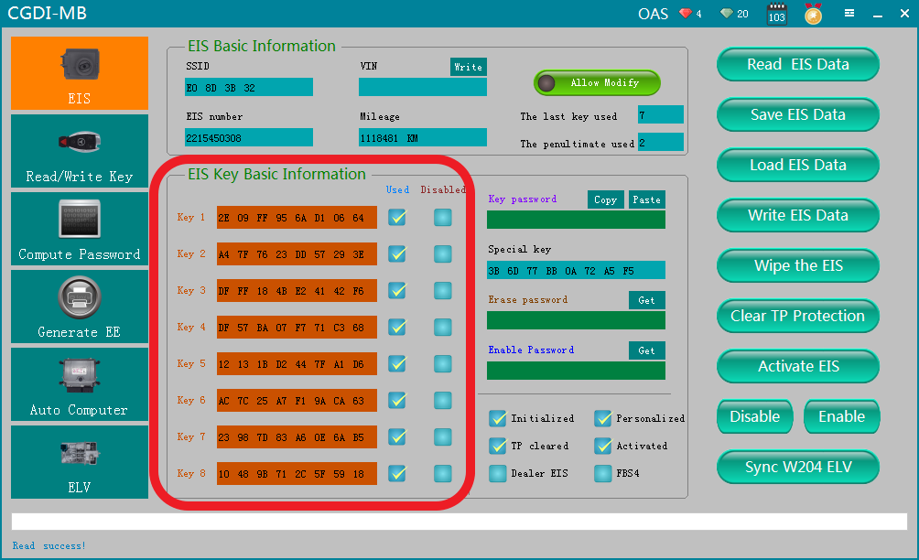
Read successfully，show that the positions for key are full

Slide 6
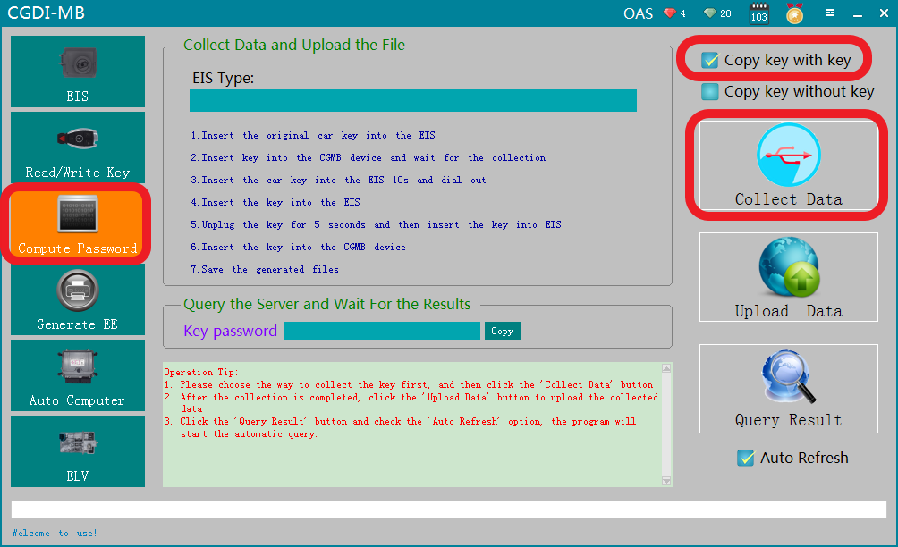
Collect data first，compute password

Slide 7
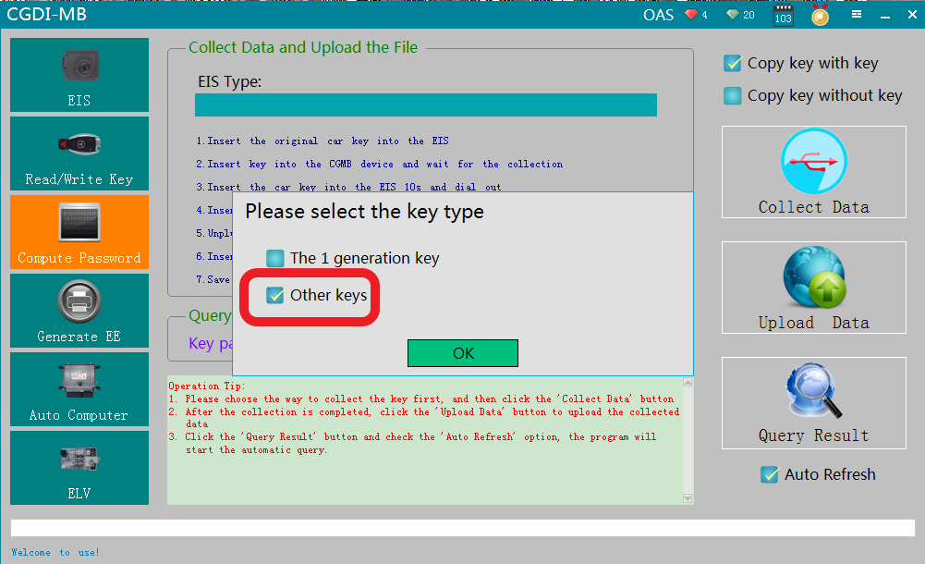
Default“Other key”，click ok

Slide 8
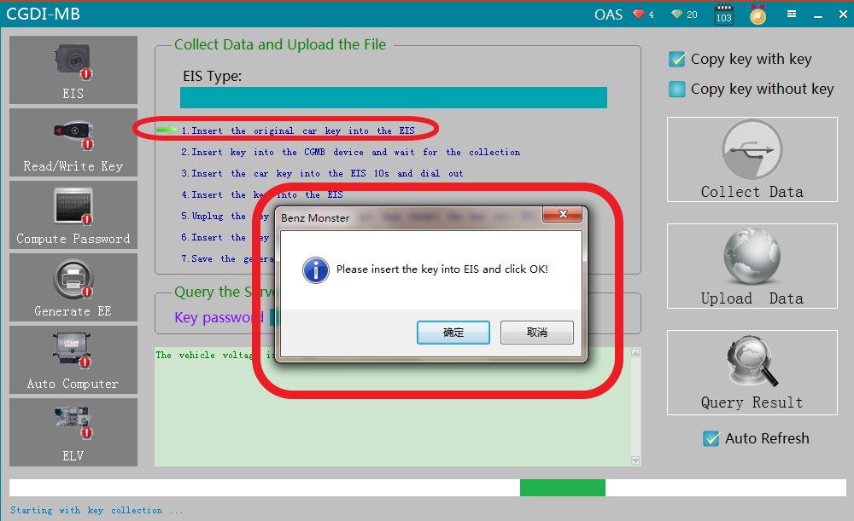
please insert the key into EIS and click OK

Slide 9
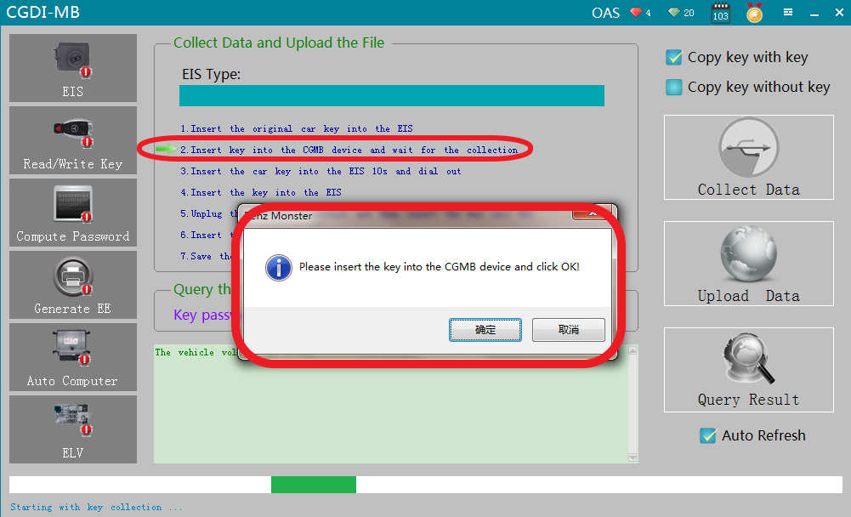
Please insert the key into the CG-MB device and click ok

Slide 10
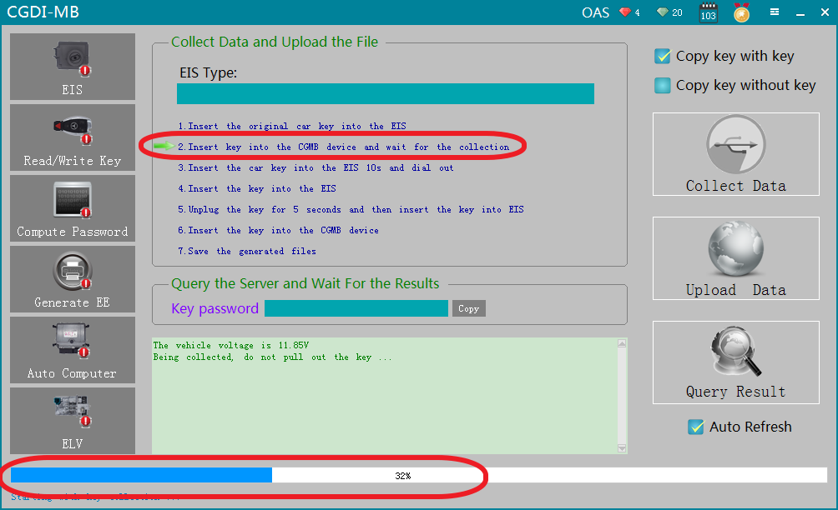
It is collecting with key，please wait ...

Slide 11
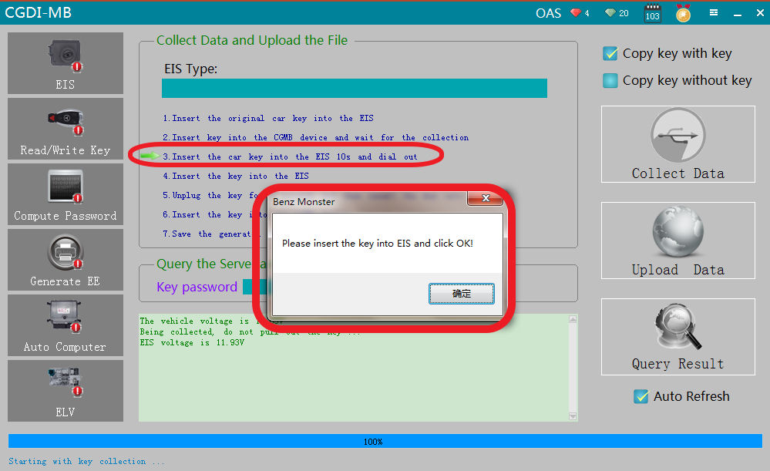
Please insert the key into EIS and click ok

Slide 12
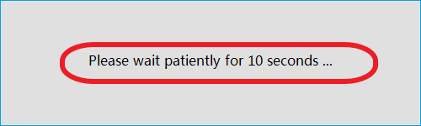
please wait patiently for 10 seconds

Slide 13
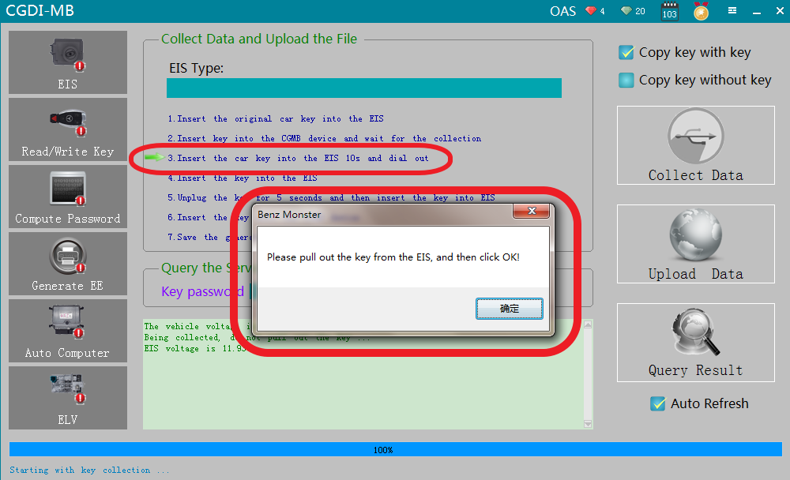
please pull out the key from the EIS, and then click ok

Slide 14
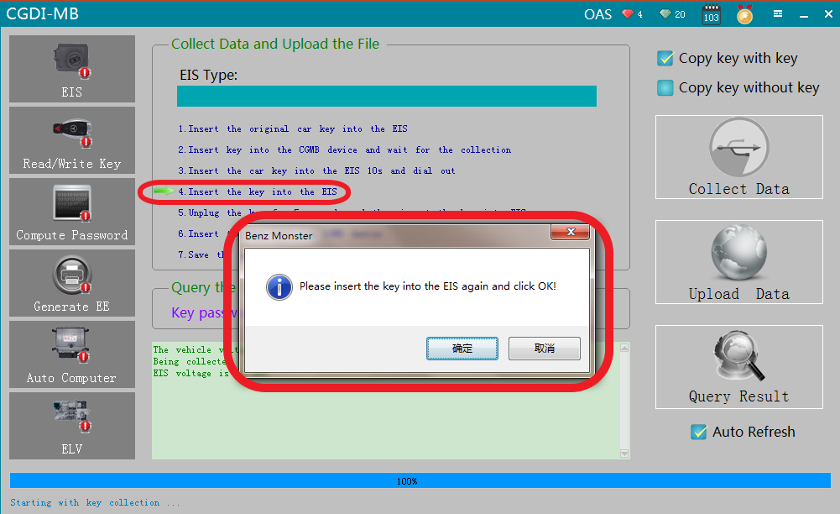
please insert the key into the EIS again and click ok

Slide 15
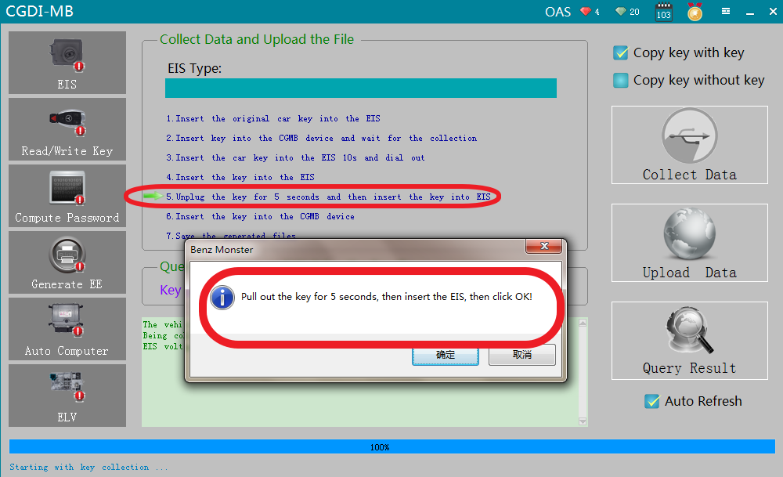
Pull out the key for 5 seconds, then insert into EIS, then click ok

Slide 16
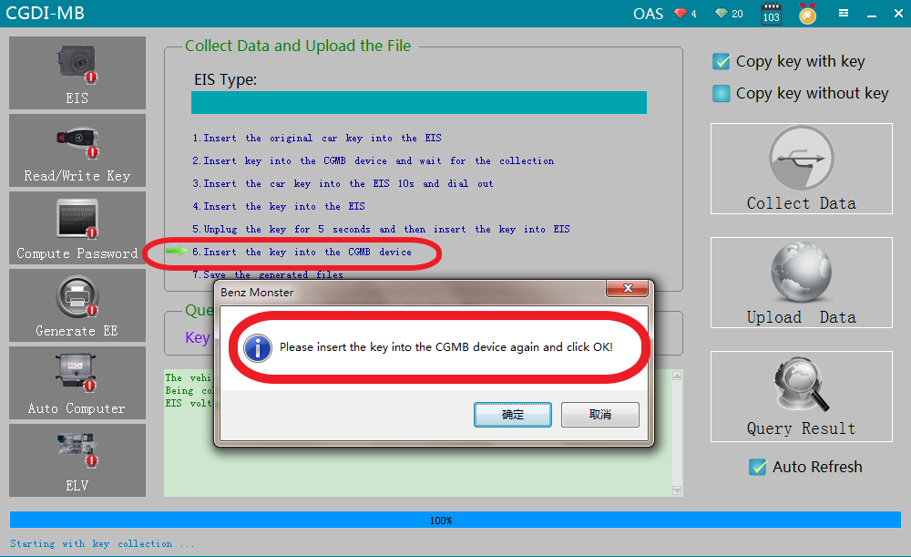
please insert the key into the CGMB device again and click ok

Slide 17
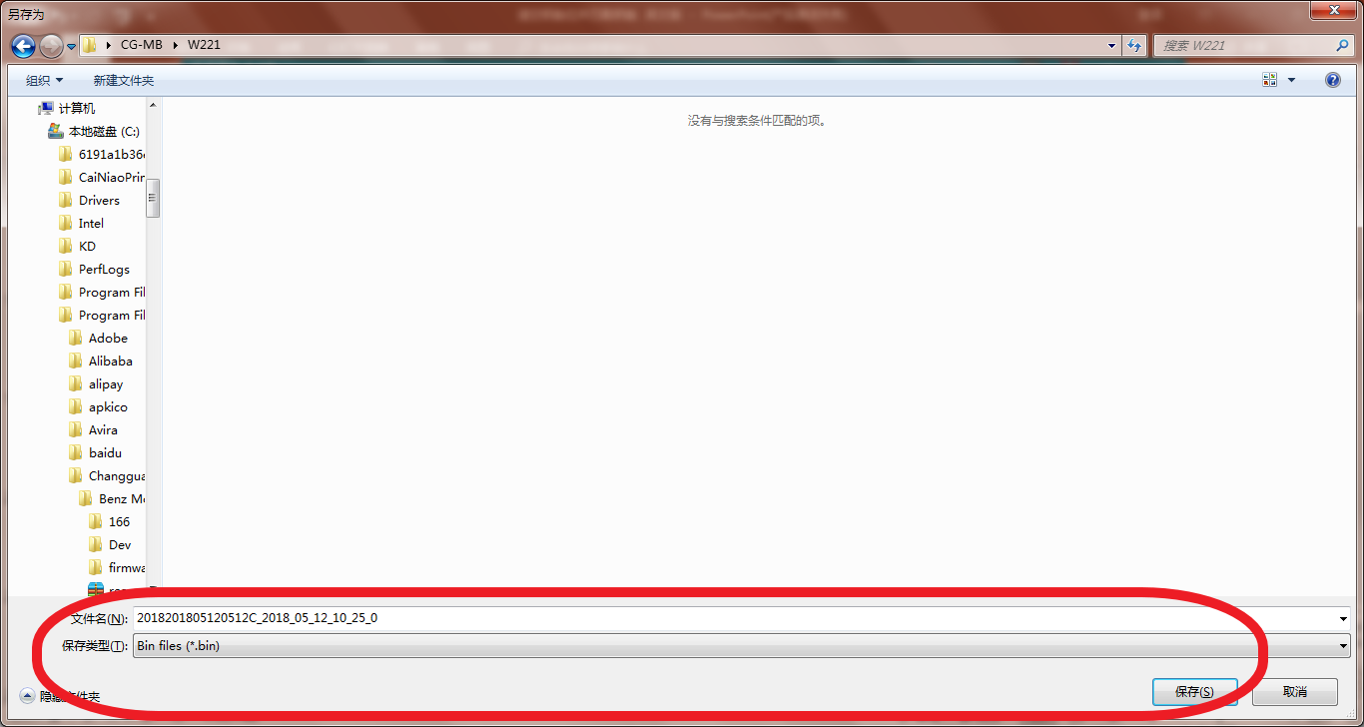
Collection end，save data，default file name

Slide 18
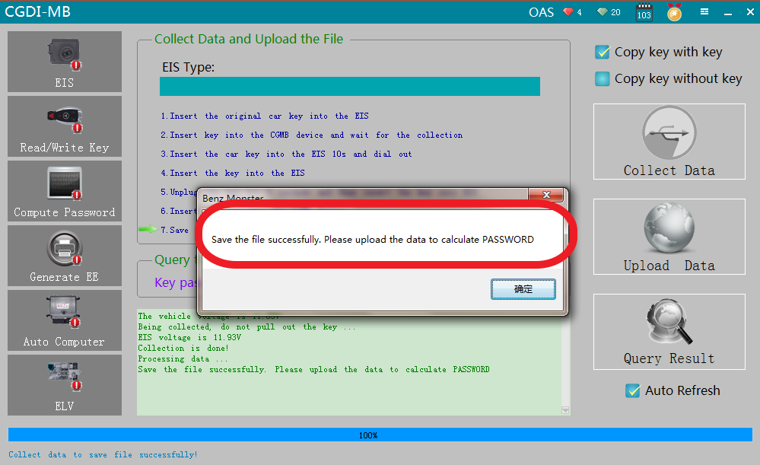
Save the file successfully

Slide 19
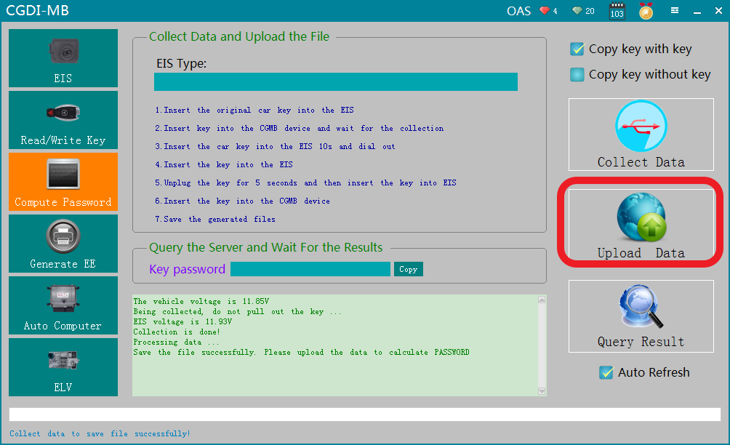
Click“Upload data”

Slide 20
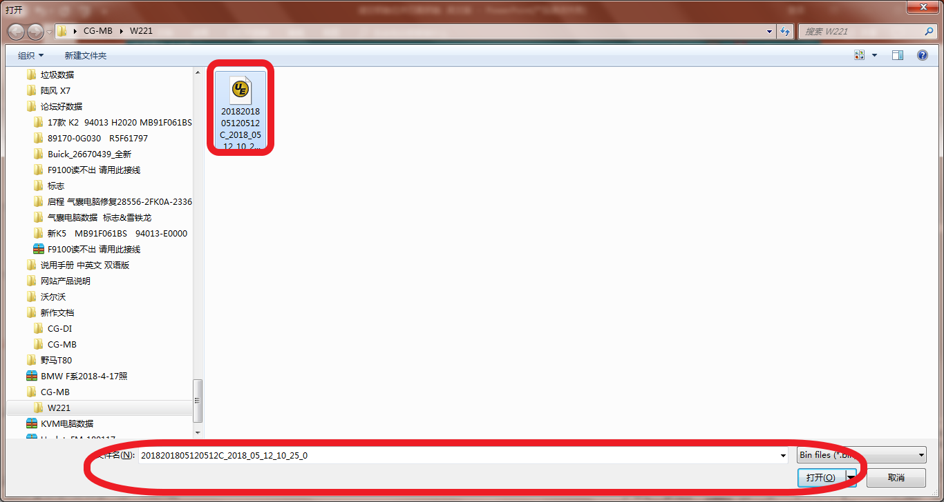
Open the data just saved

Slide 21
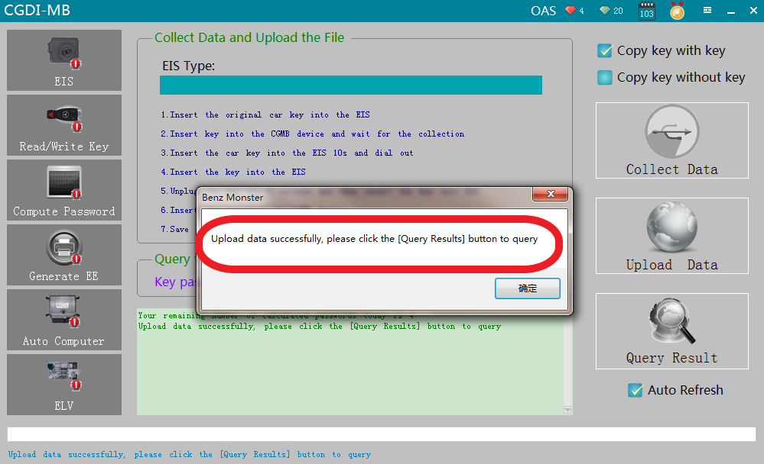
Upload data successfully

Slide 22
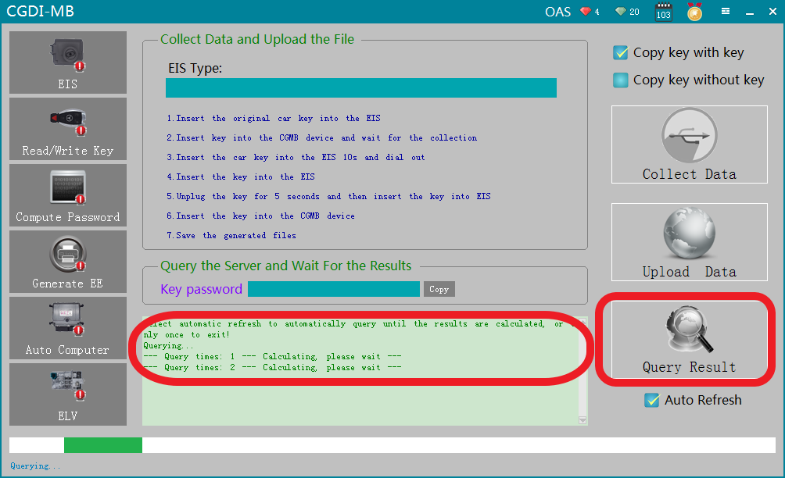
Querying，please wait...

Slide 23
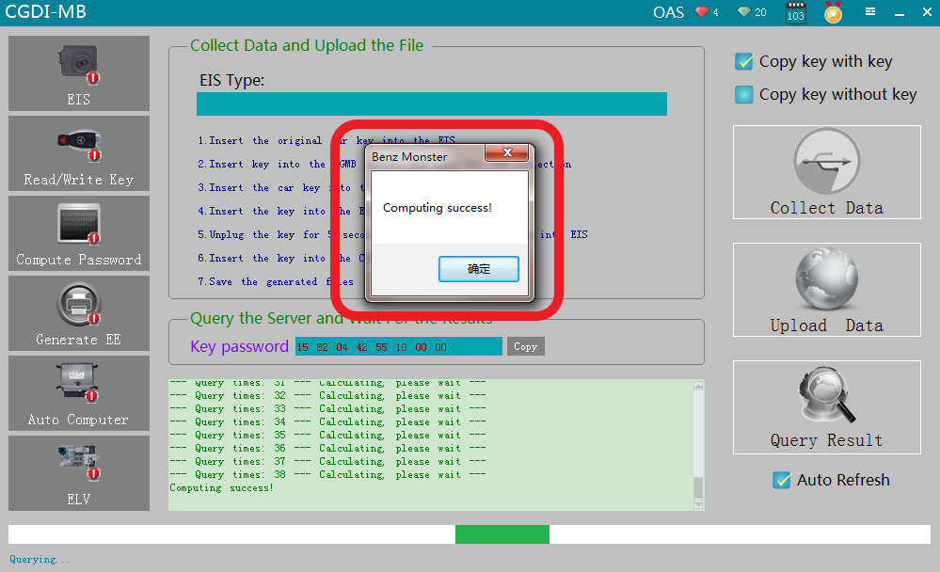
Computing success，click ok

Slide 24
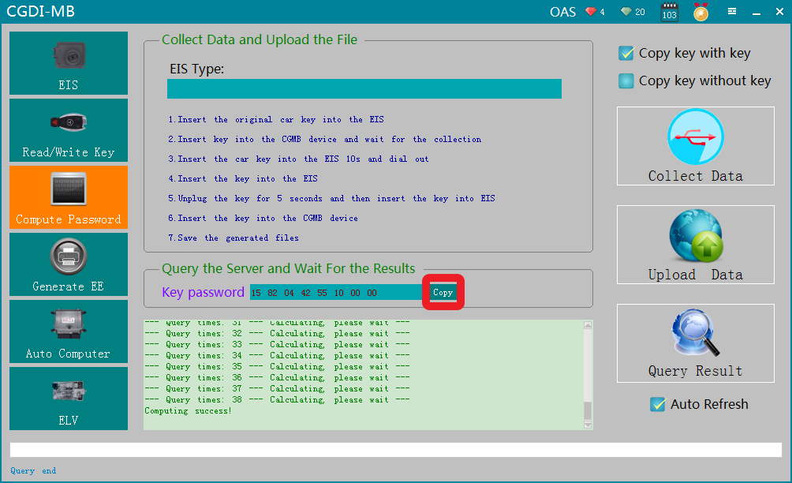
Click 'Copy'

Slide 25
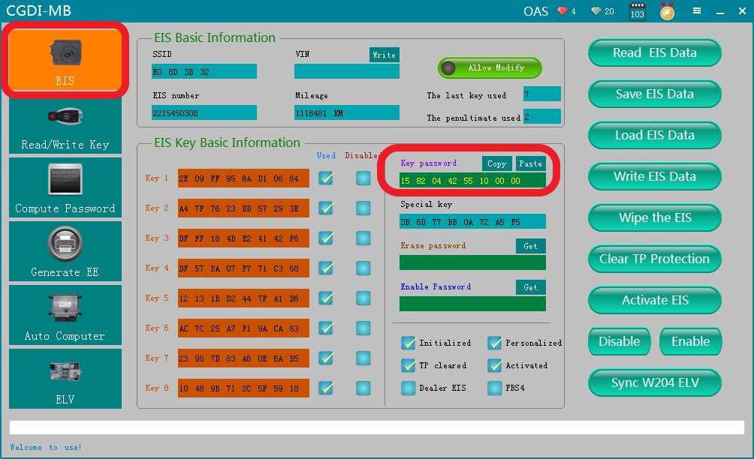
Go to “（EIS）”，and copy the password

Slide 26
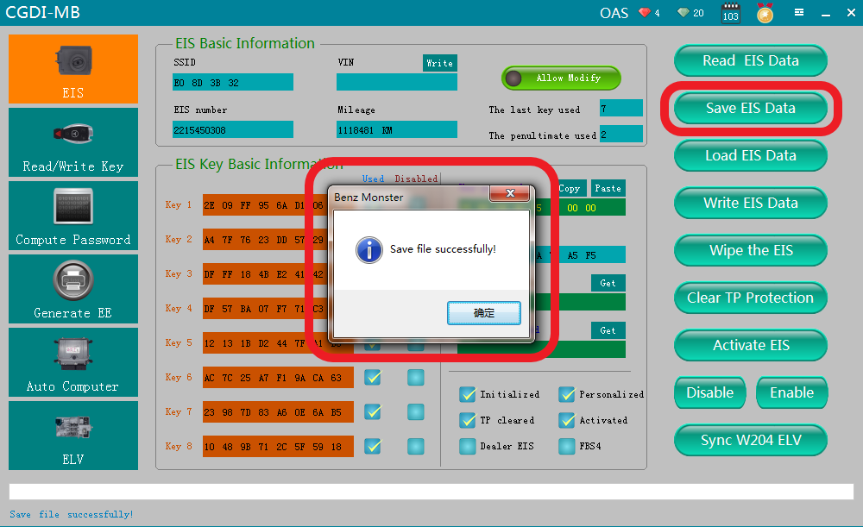
Save the EIS data with password successfully

Slide 27
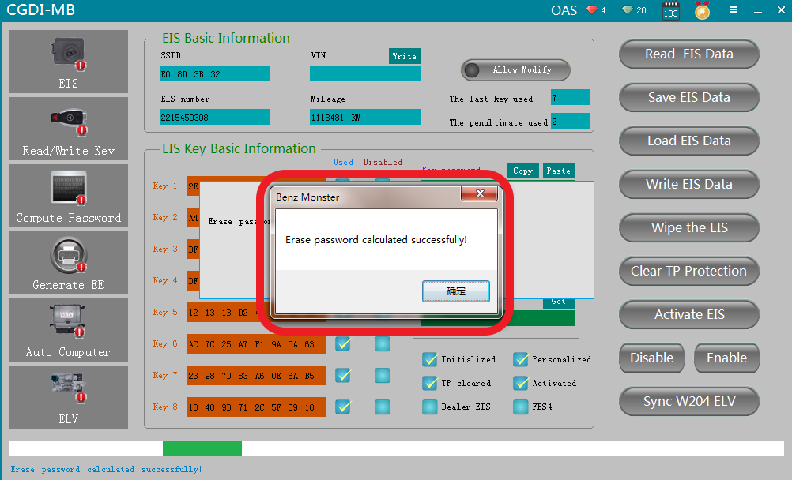
Get erase password，wait a few seconds，show that calculated successfully

Slide 28
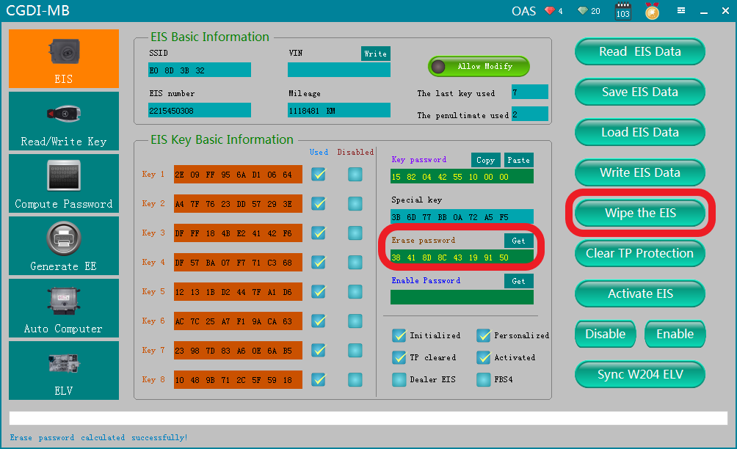
Click“Wipe the EIS”

Slide 29
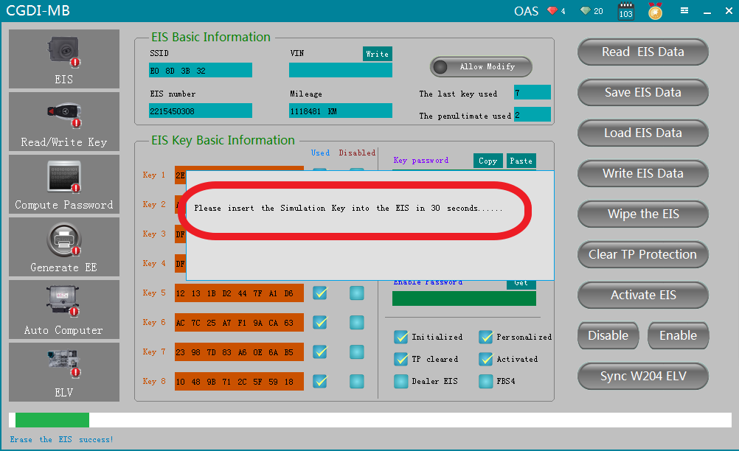
please insert the simulation key into the EIS in 30 seconds......

Slide 30
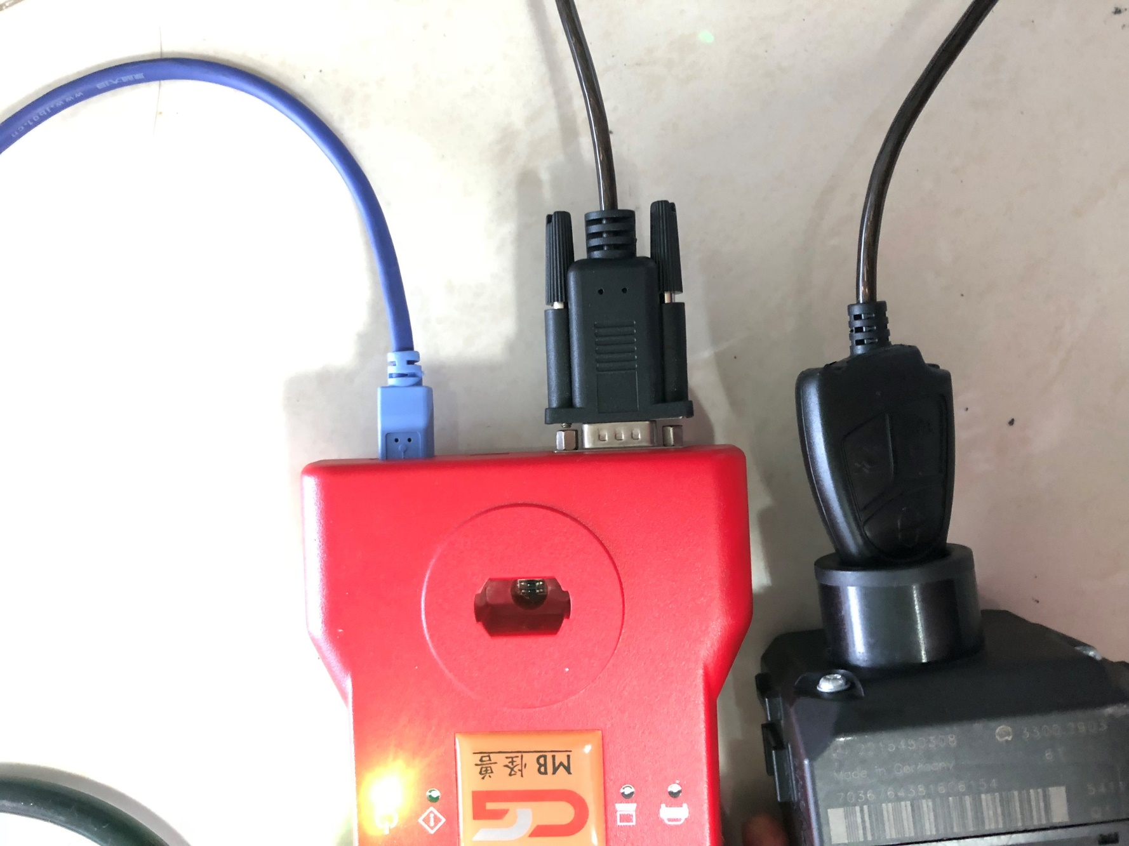
simulation key physical operation diagram

Slide 31
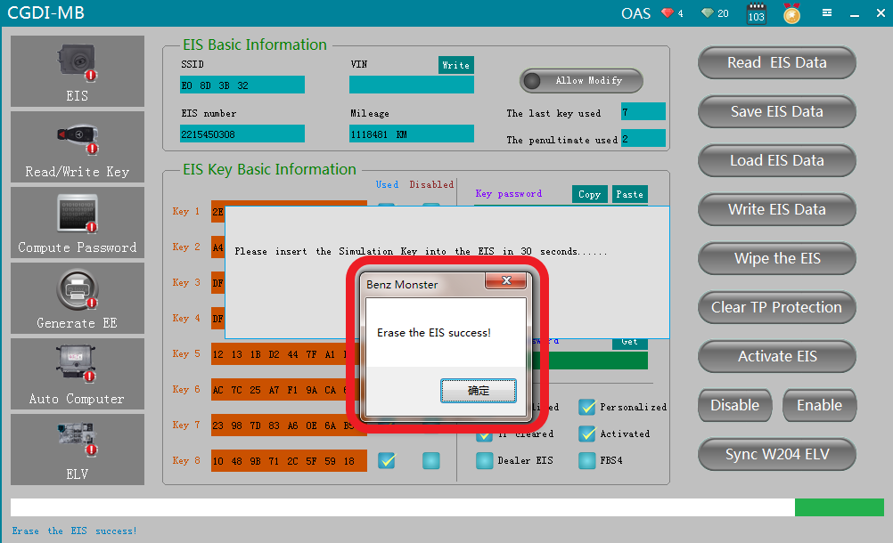
Erase the EIS success，click ok

Slide 32
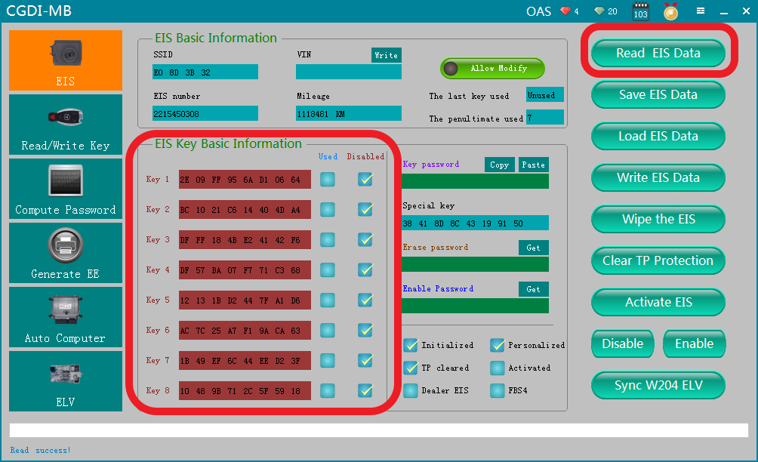
Read EIS data again，show the related information after erasing

Slide 33
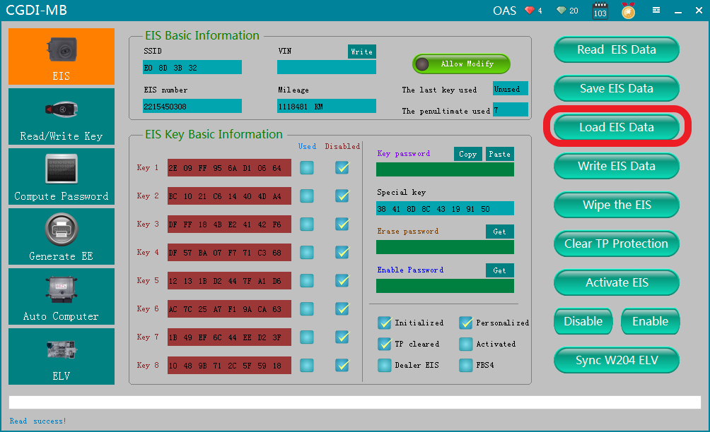
Click ''Load EIS Data''

Slide 34
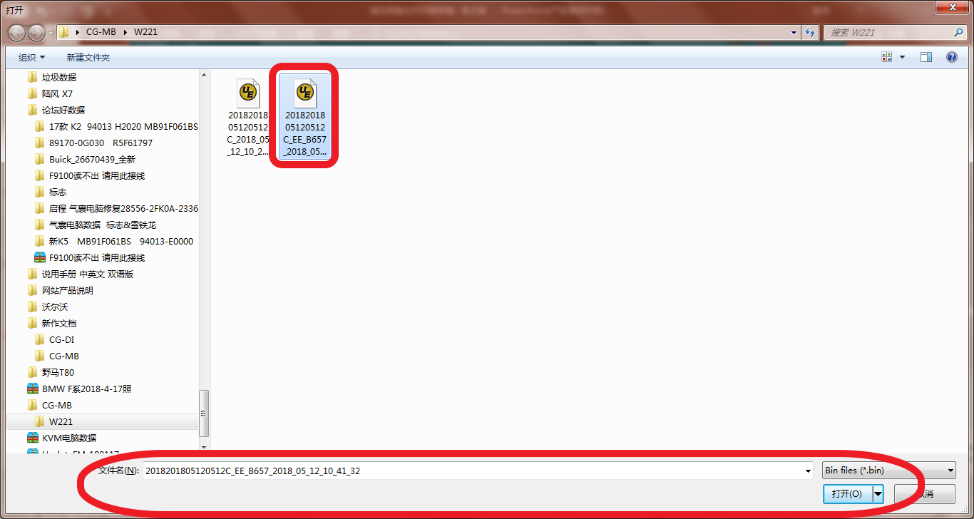
Open the EIS data just saved

Slide 35
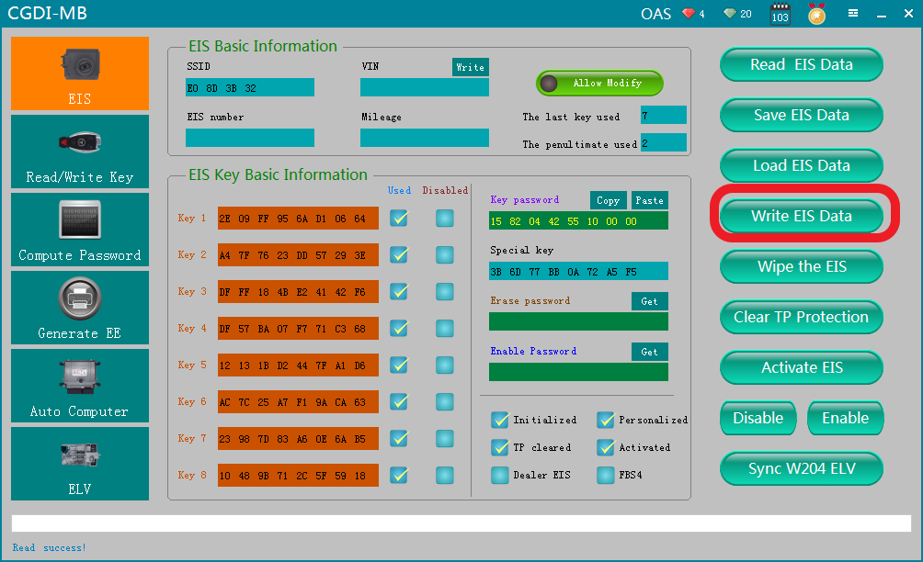
Click“ Write EIS Data”

Slide 36
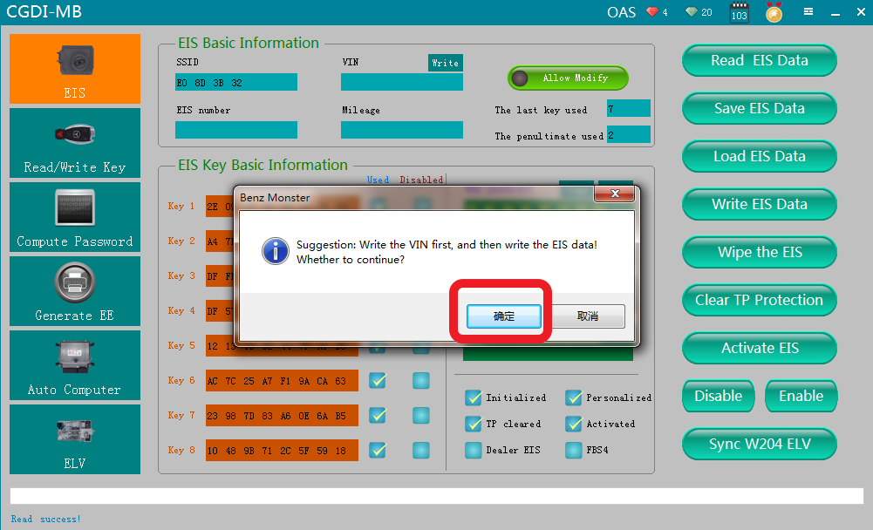
Click ok

Slide 37
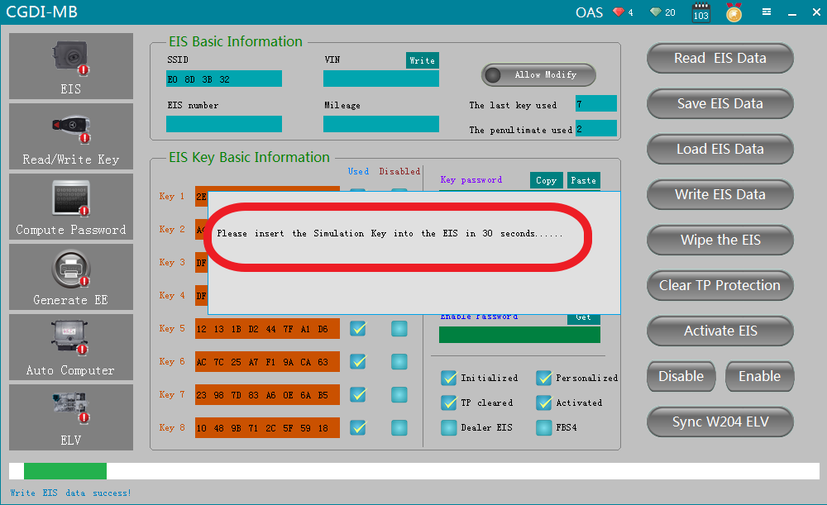
please insert the simulation key into the EIS in 30 seconds

Slide 38
simulation key physical operation diagram

Slide 39
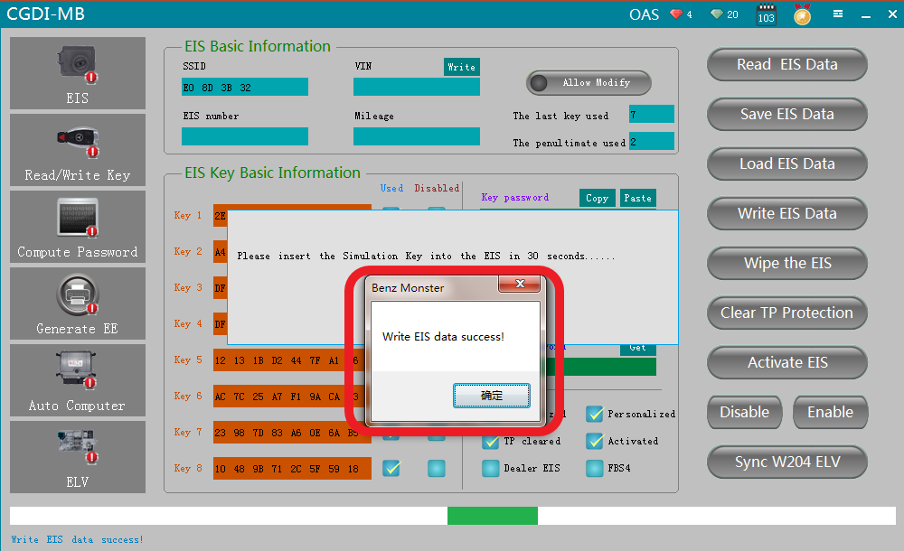
Write EIS data success

Slide 40
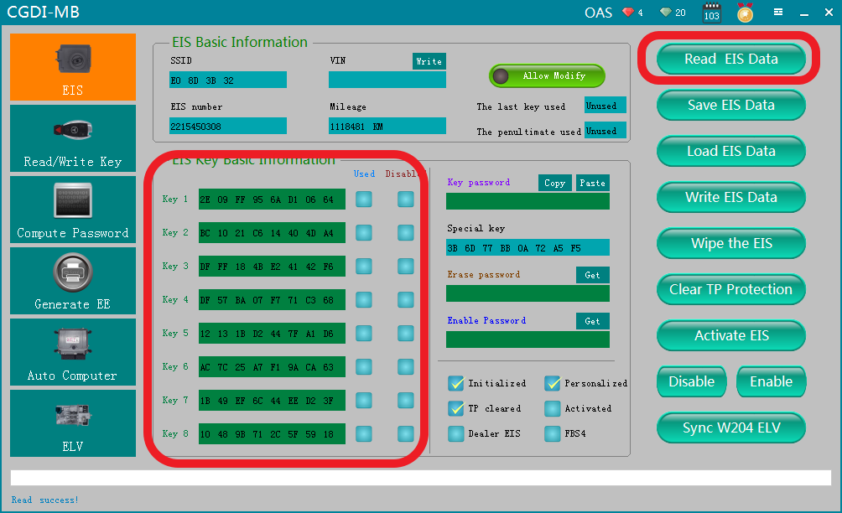
Read EIS data again，showed as above picture

Slide 41
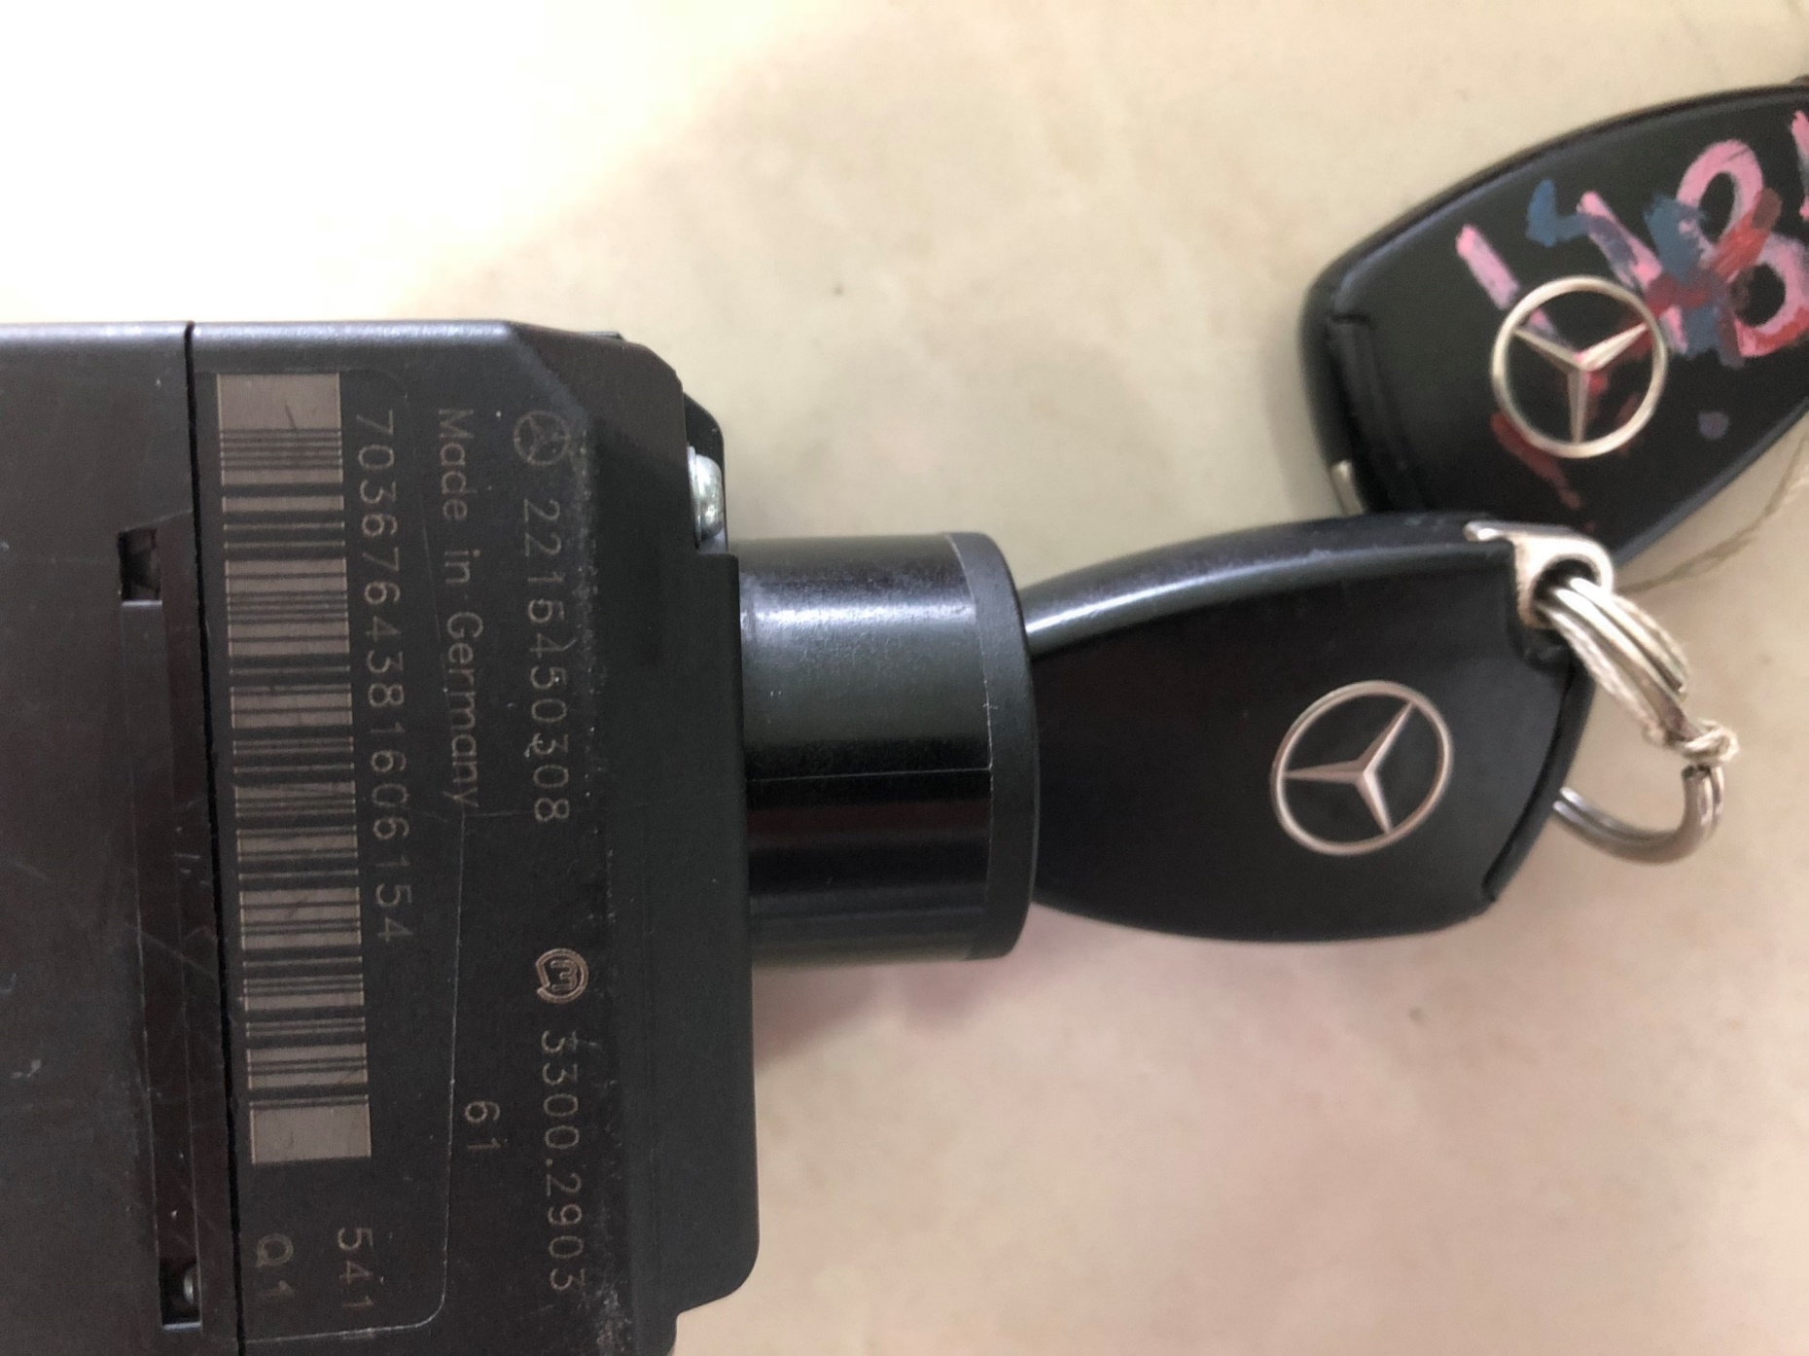
Insert the original car key into the lock to learn and start

Slide 42
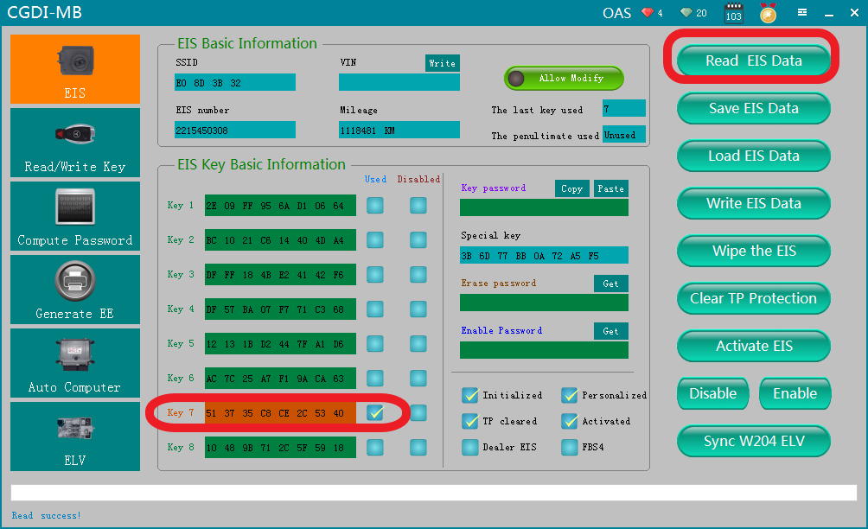
Read EIS data again，left origin key position data only，erase key position data successfully

Slide 43
The second step
Match new key

Slide 44
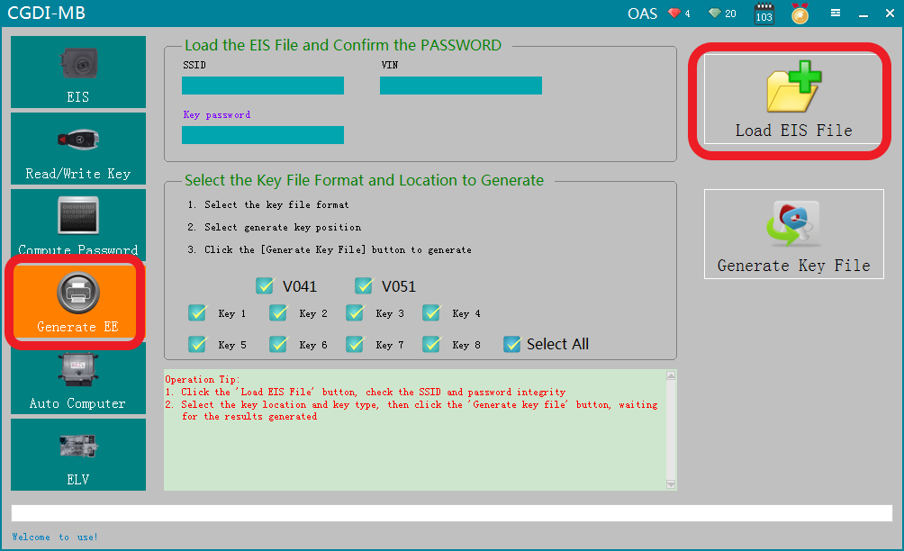
Go to “Generate EE”，load EIS file just saved

Slide 45
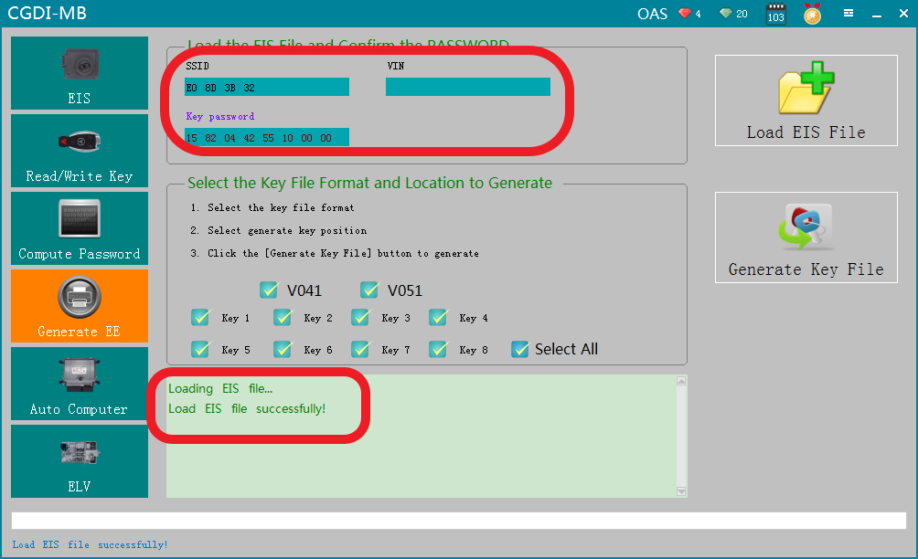
Load successfully，please check the information to see whether it is correct

Slide 46
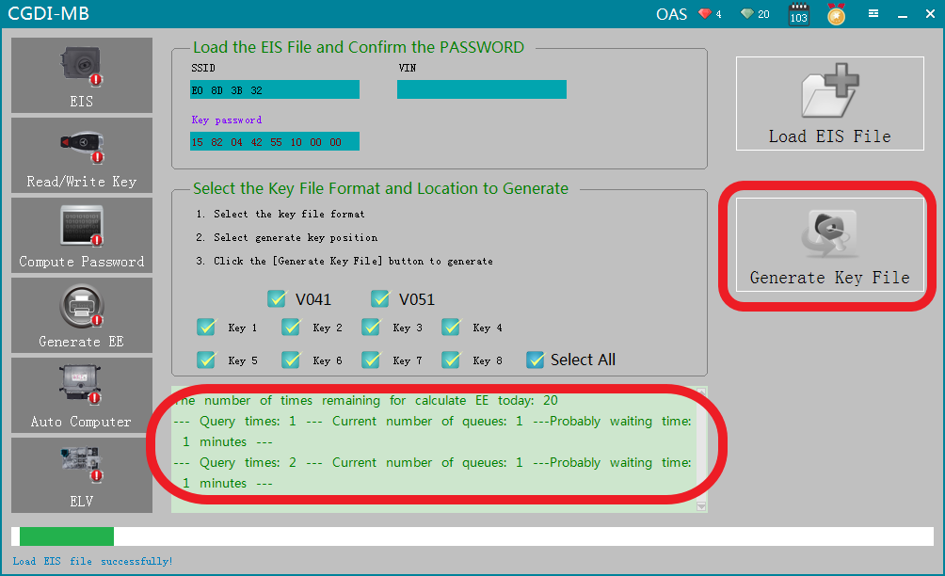
Click“Generate key file”，please wait......

Slide 47
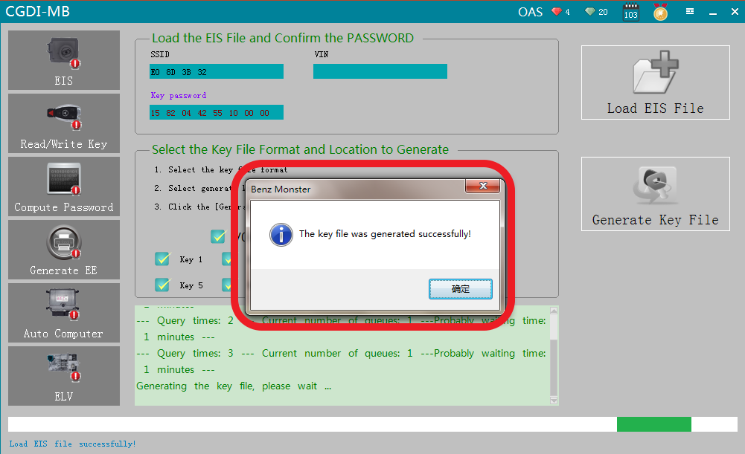
The key file was generated successfully，please save data file

Slide 48
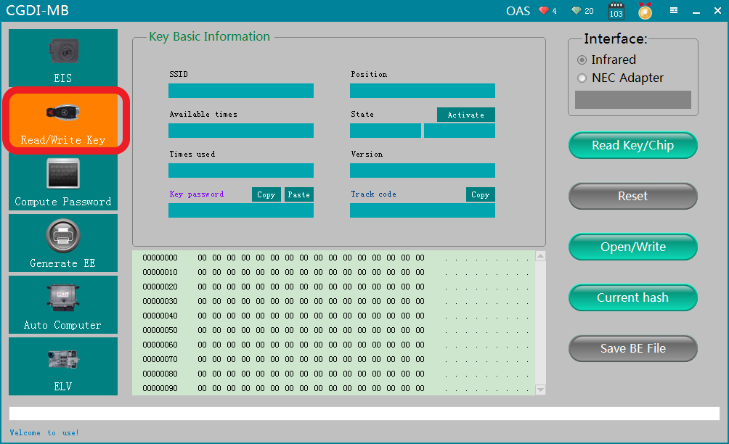
Go to “Read/write key”

Slide 49
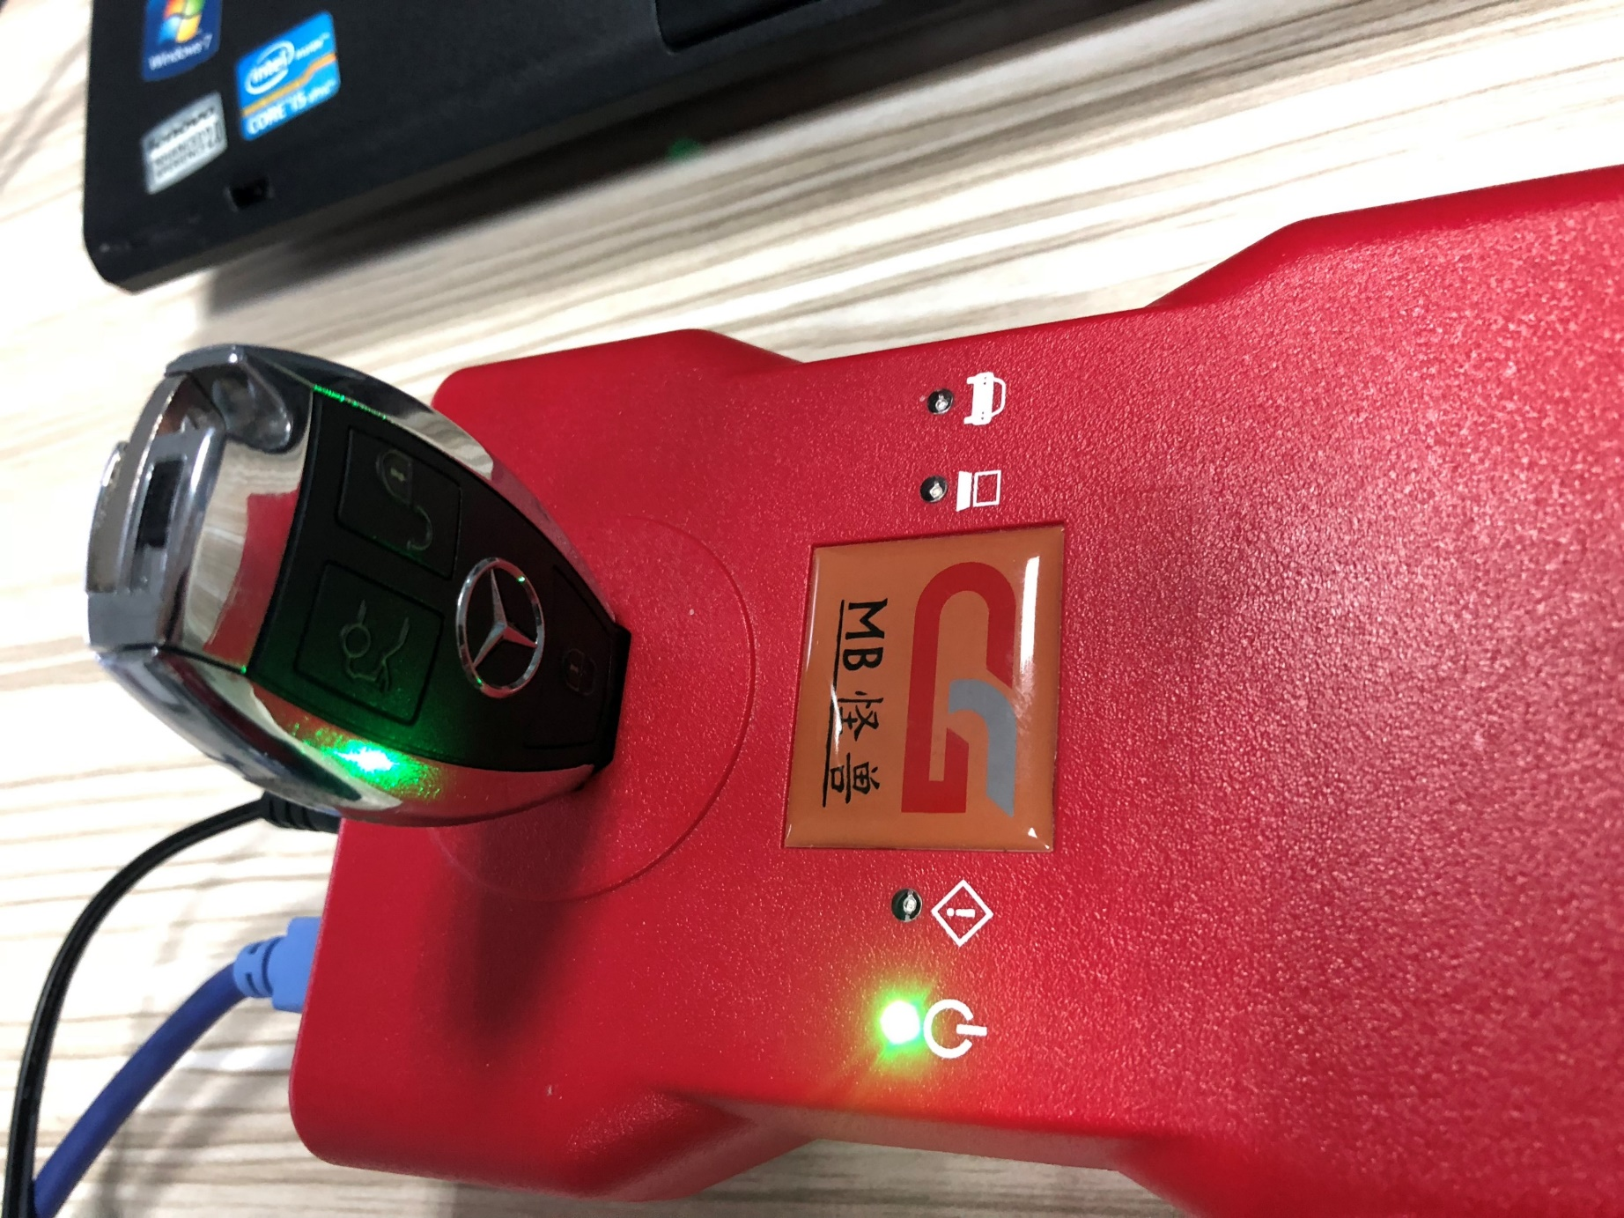
please insert the new key into CG-MB device

Slide 50
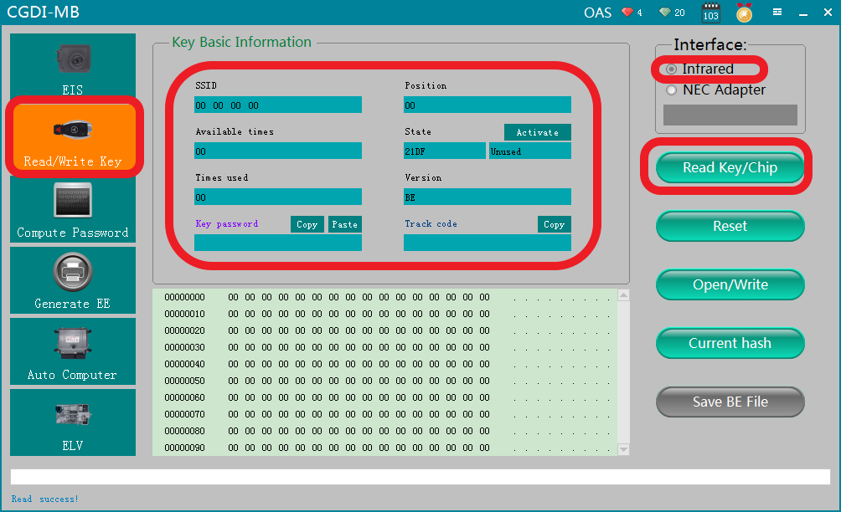
Click ''read key''，show key information

Slide 51
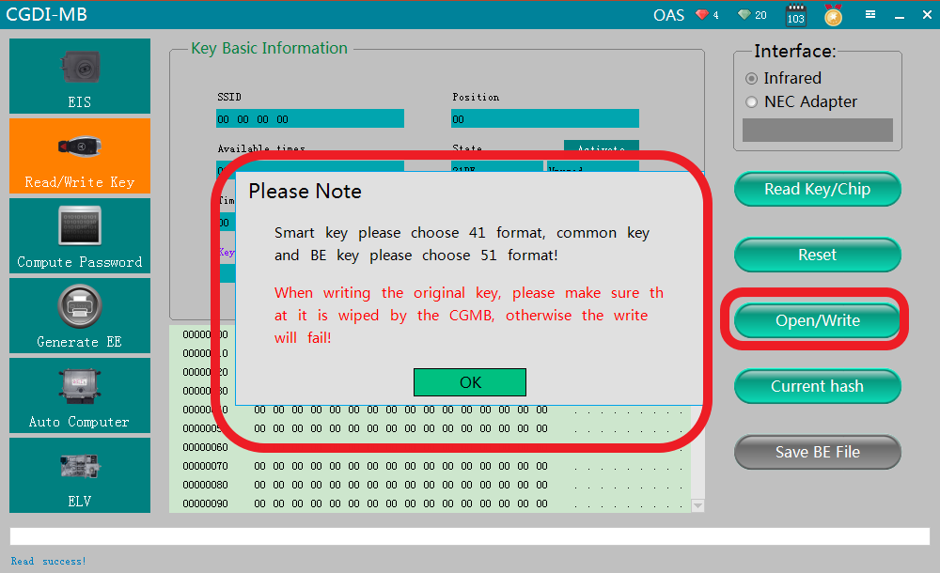
Click ''write''，please read the prompt carefully，click ok

Slide 52
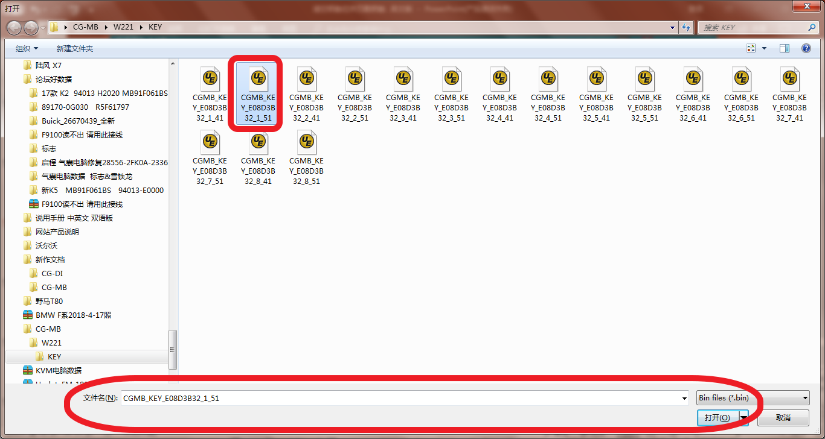
Choose一unused key position data，click and open it

Slide 53
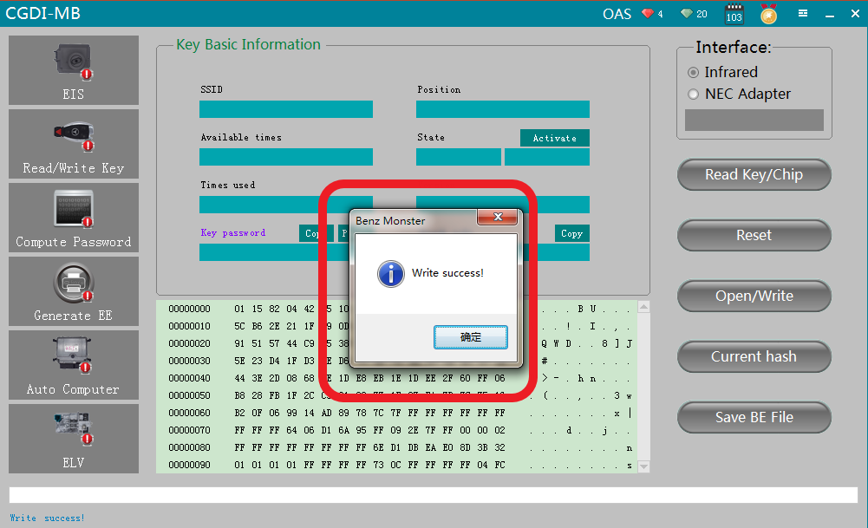
Write success

Slide 54
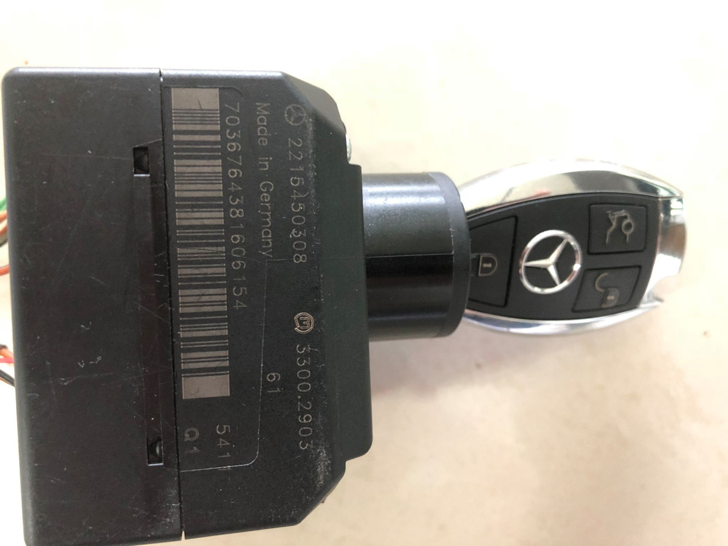
please insert the new key into EIS to learn，start the car after learning

Slide 55
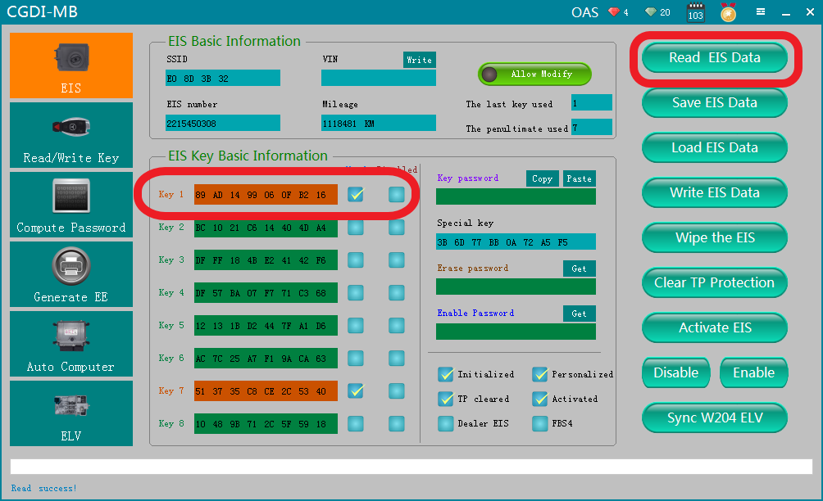
Read EIS data again，show√，combine the car to start，match new key successfully！

